Slide 1
Hack the Office
Ken Dooley
11.11.2016

Slide 2
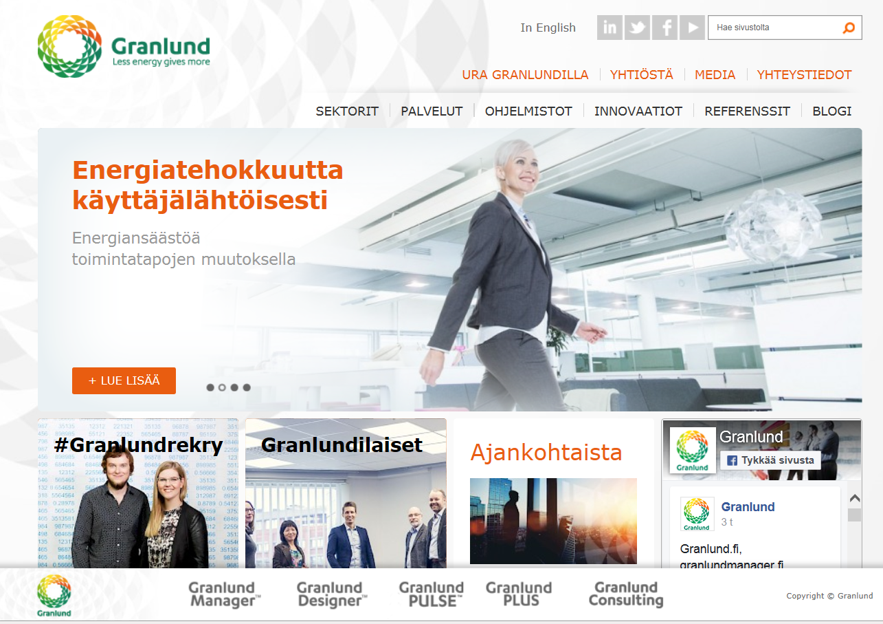
Granlund 600+ people
Expertise: Technical systems in buildings
Building Design
Real Estate Consulting
Software Development

Slide 3
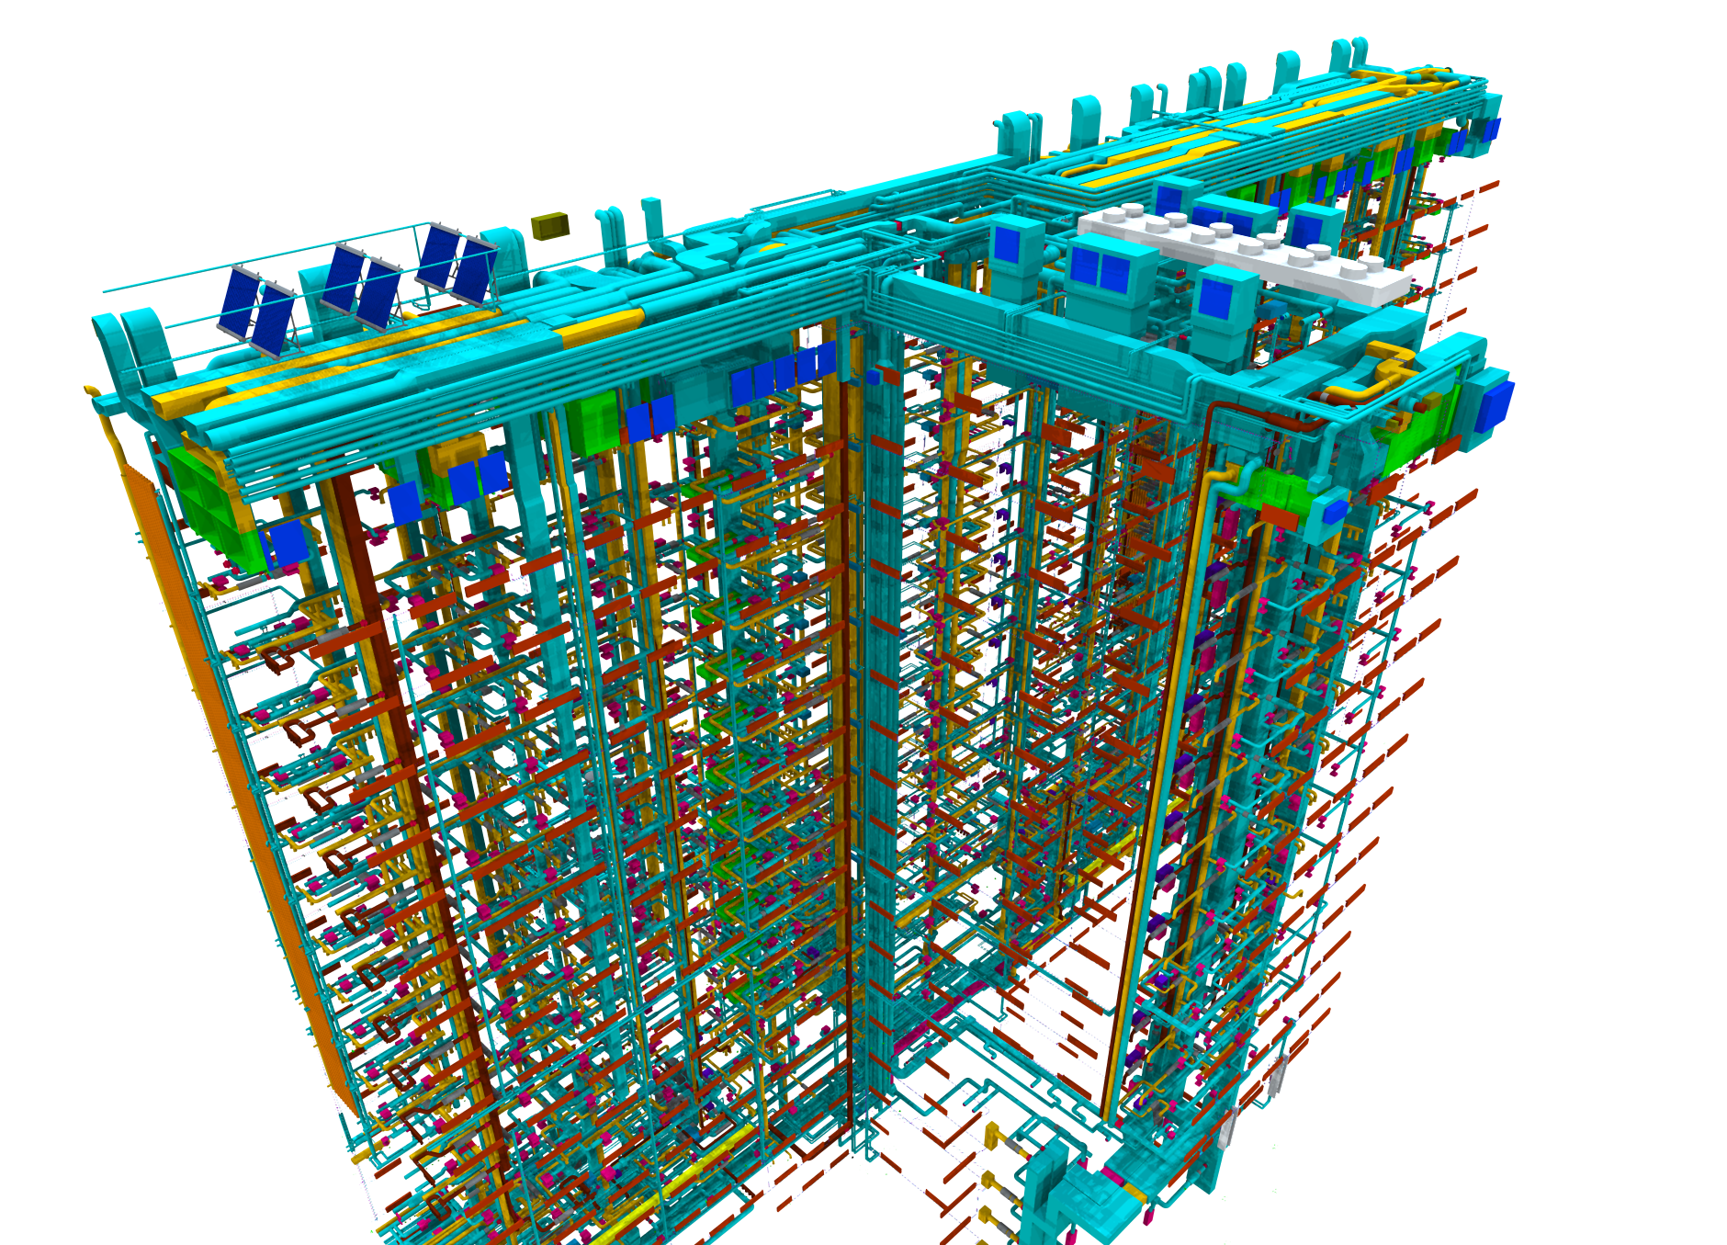
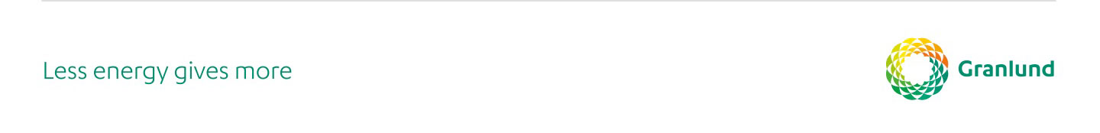

Slide 4
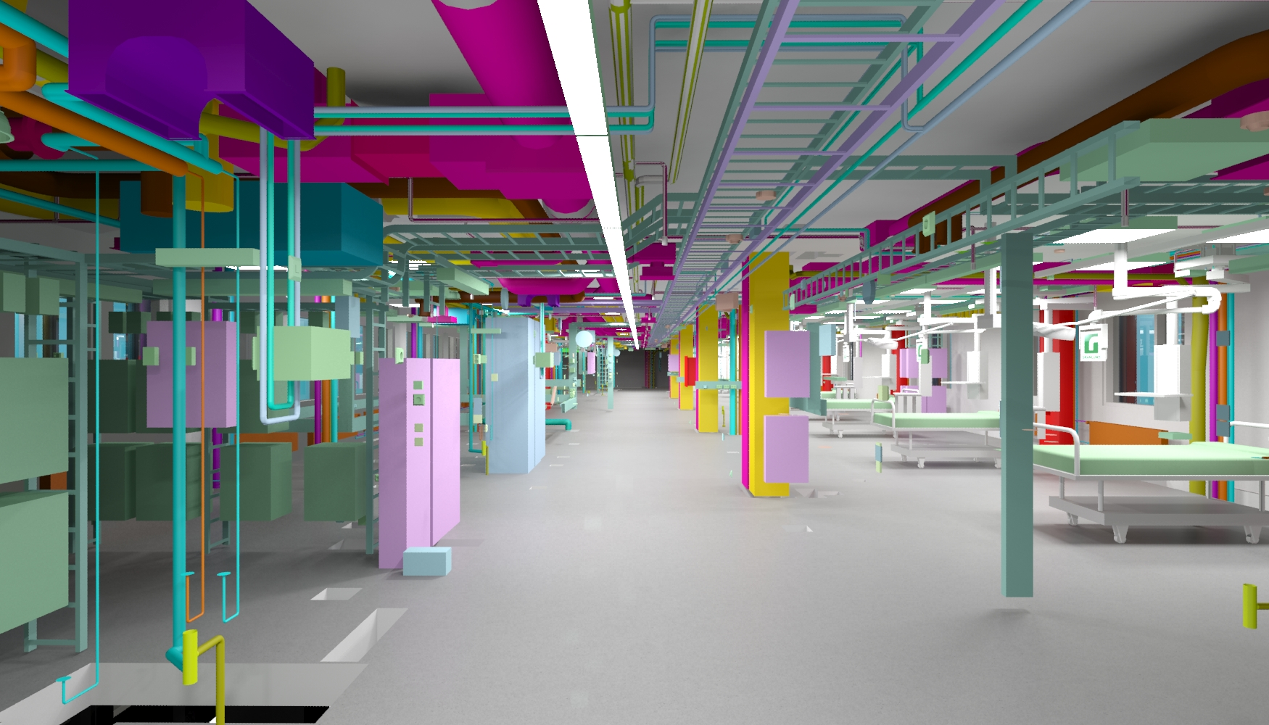

Slide 5
Healthy and Responsible Buildings
Collect, Analyse and Communicate to Building Users
Trends
Health and Well-being
Meeting the needs of the users
Responsible = Reducing environmental impact

Slide 6

Health and Wellbeing
Sickness
Ergonomics
Emotions
Daylight
IAQ
Productivity
Staff turnover
Preferences
How healthy is my building?

Slide 7
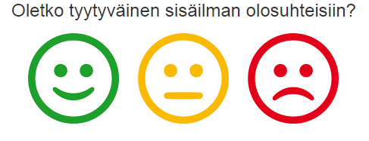
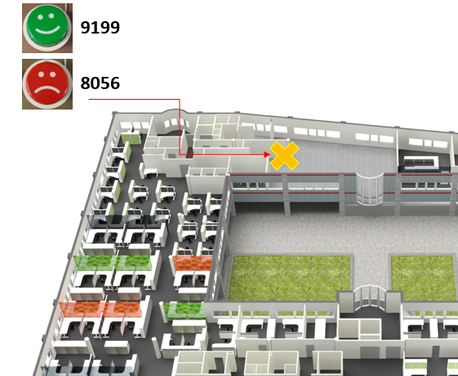
User Needs
Tell us what you:
need to do your job
want more of
want less of

Slide 8
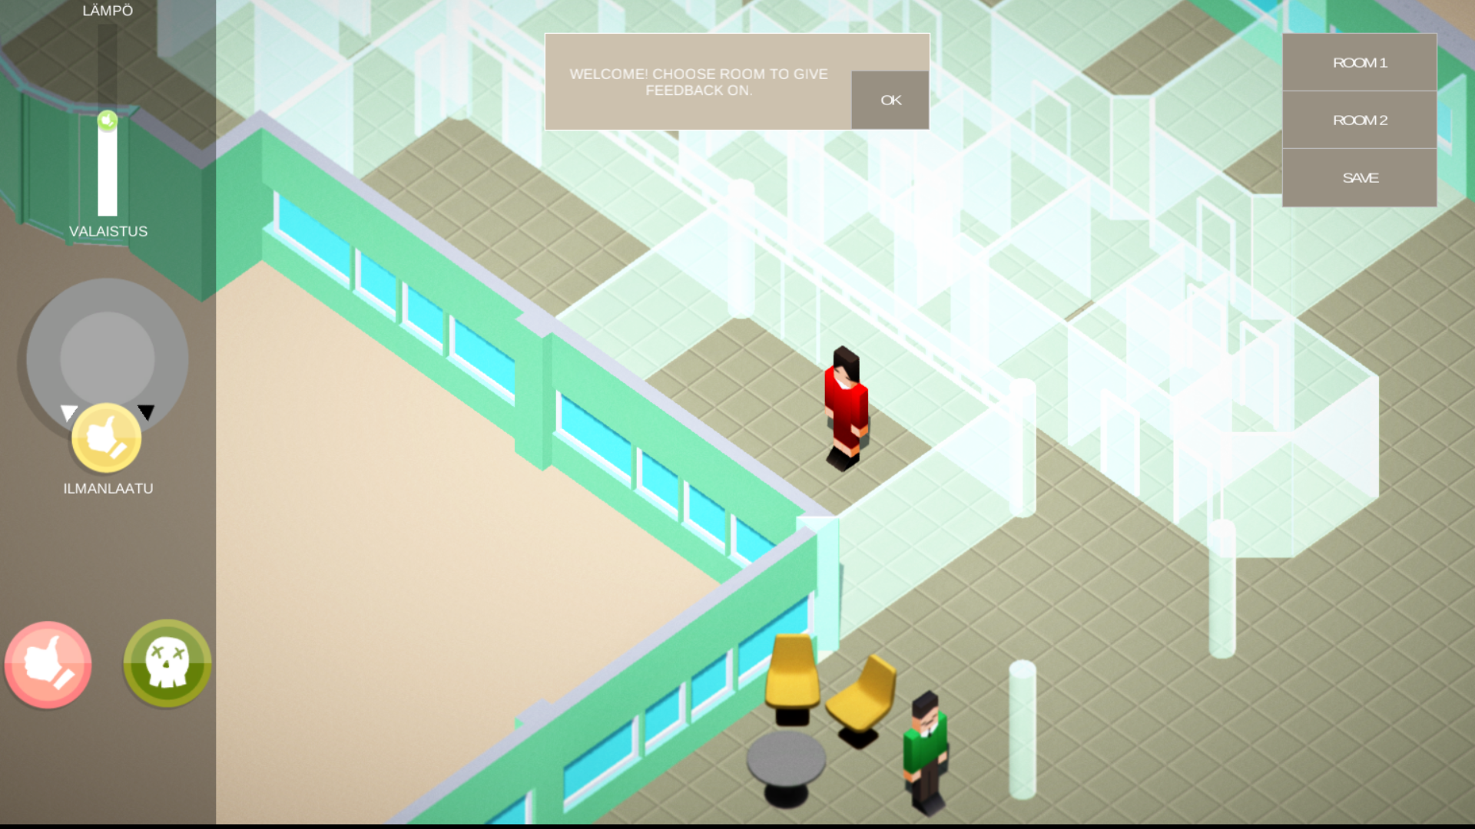
User Needs

Slide 9
Responsible Buildings
Energy*****
CO₂ generation of the building
Water
Waste
Transport emissions
Food
Light pollution

Slide 10
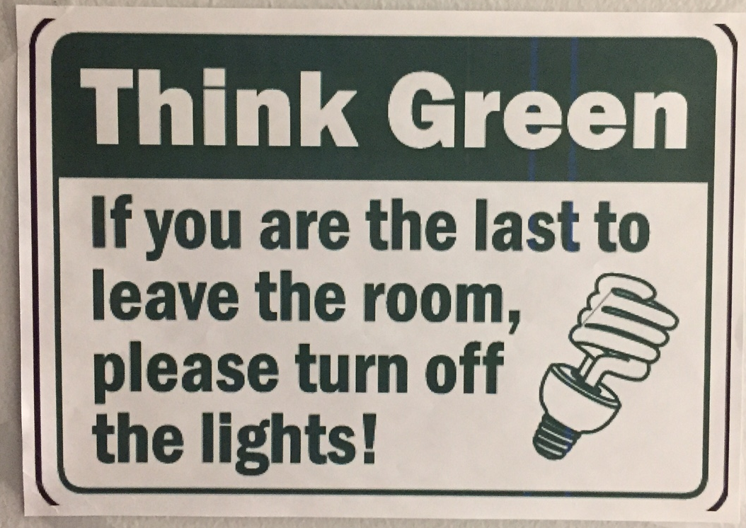
Responsible Buildings
Motivate
Educate
Compare
Competitions
Campaigns
Leaderboards
Encourage users to behave better

Slide 11
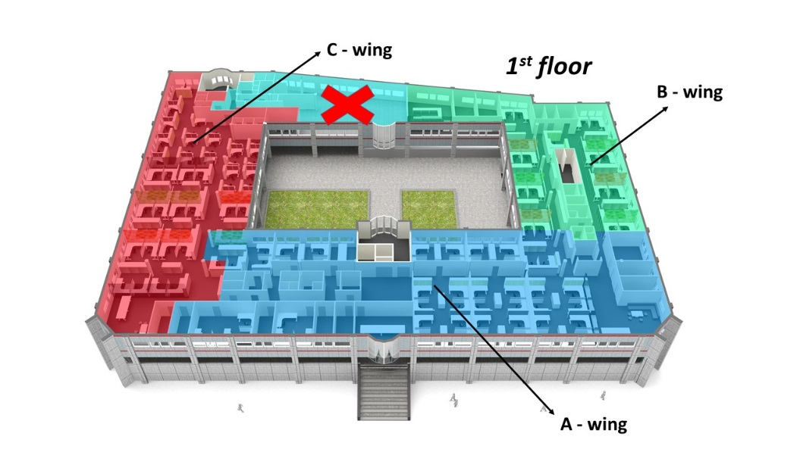
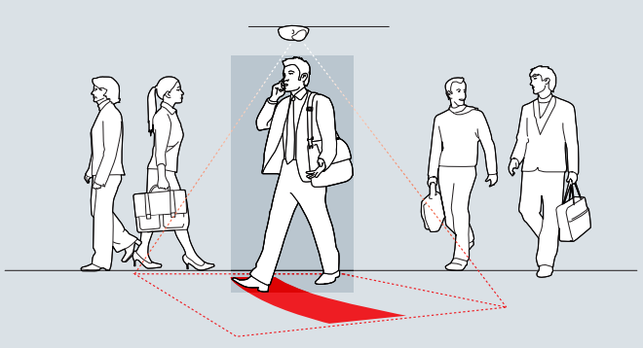
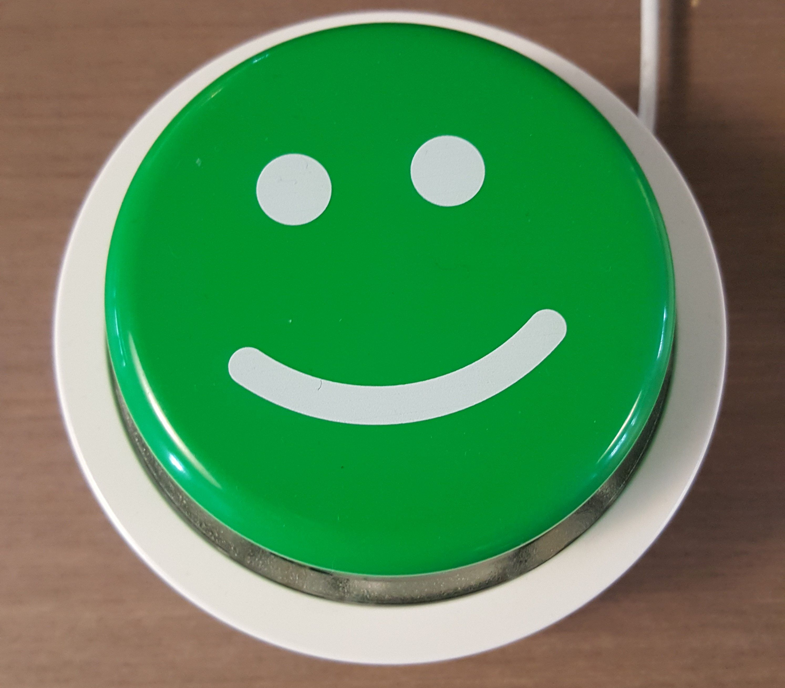
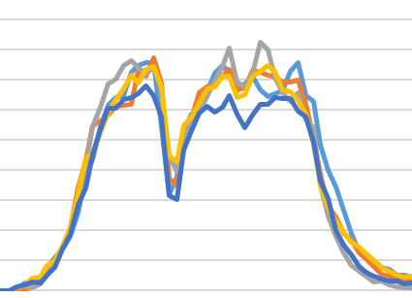
Data set
0 Energy
1 IAQ
2 Sickness
3 Occupancy
4 Emotions
5 Commuting
6 Productivity
7 Waste
Notes:
All in English – very novel data that people dont normally collect

Slide 12

Ken Dooley
Sustainability Group Manager
Granlund Consulting
ken.dooley@granlund.fi
@kendooley

Slide 13
Good Luck!

